Slide 1
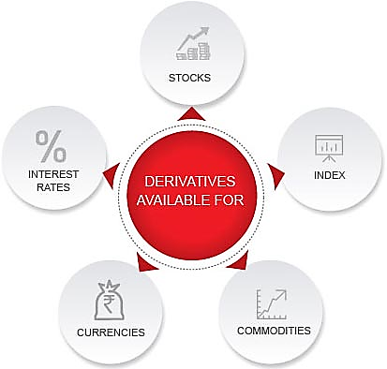
Lets Begin - What are Derivatives
A bet that something will go up or down
They are financial contracts that derive their value from an underlying asset
These financial instruments help you make profits by betting on the future value of the underlying asset
So, their value is derived from that of the underlying asset.

Slide 2
How it works
Value is derived from an asset or a group of assets
Contract between two or more parties
Change in underlying will bring change in the price of a derivative
Exchange Trades Vs Over the Counter

Slide 3
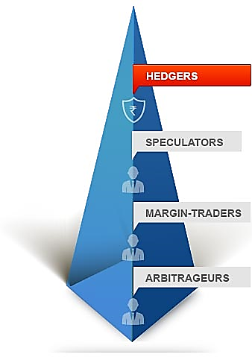
Participants in Derivative Markets
Hedgers
They use derivatives in order to reduce risk
They don’t want to miss upon anything
Risk Averse
Speculators
They love betting
To get Extra Leverage
Very Risky
Arbitrageurs
Advantage from 2 different markets

Slide 4
Basic Terminologies
Spot Contract – Agreement to Buy or Sell and Asset
Spot Price – Price at which you Buy or Sell
Long Position /Bullish – Buy
Short Position/Bearish – Sell
Expiry
Margins

Slide 5
Forward Contract
A forward contract is an agreement between two parties to buy or sell an asset
The owner of a forward contract has the obligation to buy the underlying asset at a fixed date in the future for a fixed price which is decided today
They are traded on, Over the Counter (OTC)

Slide 6
Forward and Futures
Forward and Futures contracts lock in a price today for the purchase or sale of something in a future time period
Futures and Forwards commit both parties to the contract to take a specified action
Having a long position means you are committed to buy the good at the specified price in the future

Slide 7
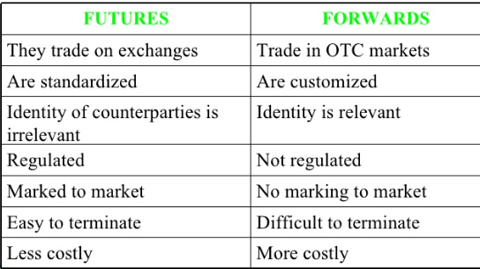
Futures Vs Forwards

Slide 8
How Future Contract work
No money changes hands between the long and short parties at the initial time the contracts are made
Only at the maturity of the forward or futures contract will the long party pay money to the short party and the short party will provide the good to the long party.
One has no intention of taking delivery of the commodity
When one “sells” a futures contract, no intention of selling the commodity. Again, post margin.

Slide 9
More on Future Contracts
The life of one contract is 3 months.
At any point of time, 3 futures contract will be available for trading with different time limit to expiry – 1month, 2 month and 3 month contract. ( Also called near month, mid month and far month contracts)
DIFFERENT TYPES OF FUTURES
Stock futures and stock index futures – traded on the NSE
Commodity futures – traded on MCX / NCDEX
Interest rate futures – traded on NSE

Slide 10
Pricing and Valuation
Every day, the exchange defines a price called the “settle” price, which is essentially the last trade on that day
Every day until expiration a buyer’s margin account is credited (or debited if negative) with the amount: change in settle price × contract amount
If contract is cash settled, on the last day the margin account is credited with (cash settle price-last settle price)×contract amount.
If contract is physical delivery, on last day buyer must receive commodity

Slide 11
Initial Margin
Long and the short parties must deposit money in their brokerage accounts.
Approx. – 15-20 % of the total value of the contract
Not a down payment, but instead a security deposit to ensure the contract will be honored
Maintenance Margin – If Market is not in favour of your contract then the investor is required to bring the account balance back to the initial margin requirement

Slide 12
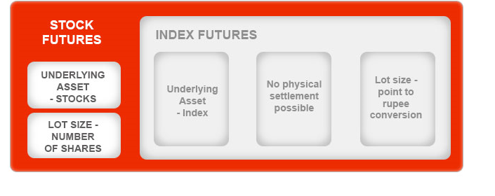
Stock Futures Vs Index Futures

Slide 13
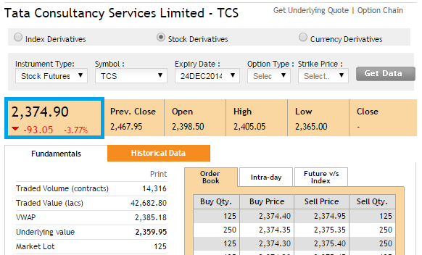
Live Trading - Example

